Slide 1
ACADEMIC REVIEW · PROJECT DASHBOARD
Hotel Revenue Management Dashboard
Project scope, dashboard experience, data model, and validation approach.
POWER BI · HOTEL PERFORMANCE · REVIEW EDITION
PRESENTED BY ADITYA KUMAR
ROLL NO. 2400320100077
ABES ENGINEERING COLLEGE
Notes:
Introduce the project as a focused reporting layer for turning hotel data into reviewable management decisions. The presentation covers the scope, experience, data model, KPI discipline, interaction, and acceptance evidence.

Slide 2
02
PROJECT PURPOSE
01 · SYSTEM ROLE
The project turns hotel data into decisions
A focused Power BI reporting layer makes performance information easier to interpret, filter, and maintain across a defined academic dataset.
01
02
03
Reporting layer
Centralized indicators
Designed for users
Power BI reporting layer over 8,000 reservations and 3,650 daily hotel records.
Occupancy, ADR, RevPAR, room revenue, ancillary revenue, cancellation rate, lead time, and channel mix.
Managers, analysts, operations users, and report maintainers reviewing 10 simulated hotels in India.
SOURCE · hotel-revenue-management-dataset-1ev14h99 · INR · 2025-10-01 → 2026-09-30
SYSTEM INTENT · DECISION SUPPORT, NOT AUTONOMOUS REVENUE CONTROL
SO WHAT
One reporting layer connects hotel performance data to the decisions reviewers need to examine—without implying the source tables are a single reconciled transaction ledger.

Slide 3
03
SCOPE CONTROL
02 · BOUNDARIES
Clear boundaries keep the system focused
The review covers a synthetic academic dataset, not a live hotel operating system.
IN SCOPE
OUT OF SCOPE
Build the reporting path
Do not expand the product
Excel ingestion, cleaning, and semantic modeling
8,000 reservations and 3,650 daily records across 10 simulated Indian hotels
DAX KPIs, interactive filtering, refresh, export, and controlled sharing
Reservations, payments, and live property-management integration
Inventory changes and autonomous revenue decisions
Treating independent booking and daily-performance tables as an exact reconciliation ledger
SOURCE · hotel-revenue-management-dataset-1ev14h99 · SYNTHETIC DATA FOR ACADEMIC USE
BOUNDARY TEST · REPORTING AND ANALYSIS, NOT OPERATIONAL EXECUTION
SO WHAT
The dashboard explains performance across the defined 365-day scope; it does not run the hotel.

Slide 4
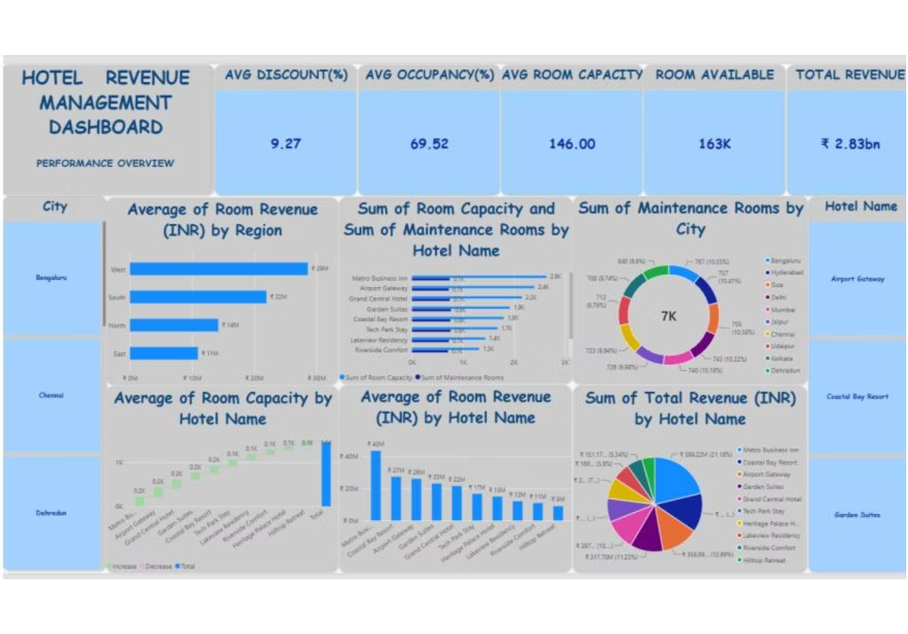
04
DASHBOARD OVERVIEW
03 · PERFORMANCE READ
The dashboard gives reviewers a fast performance read
The supplied view covers Bengaluru, Chennai, and Dehradun, while the dataset summary defines 10 simulated hotels across India.
Coverage includes occupancy, ADR, RevPAR, room revenue, ancillary revenue, cancellation rate, lead time, and channel mix.
9.27% average discount | 69.52% average occupancy
146 average room capacity | 163K rooms available
₹2.83bn total revenue
CURRENCY · INDIAN RUPEES (INR) · 365 DAYS · 2025-10-01 → 2026-09-30

Slide 5
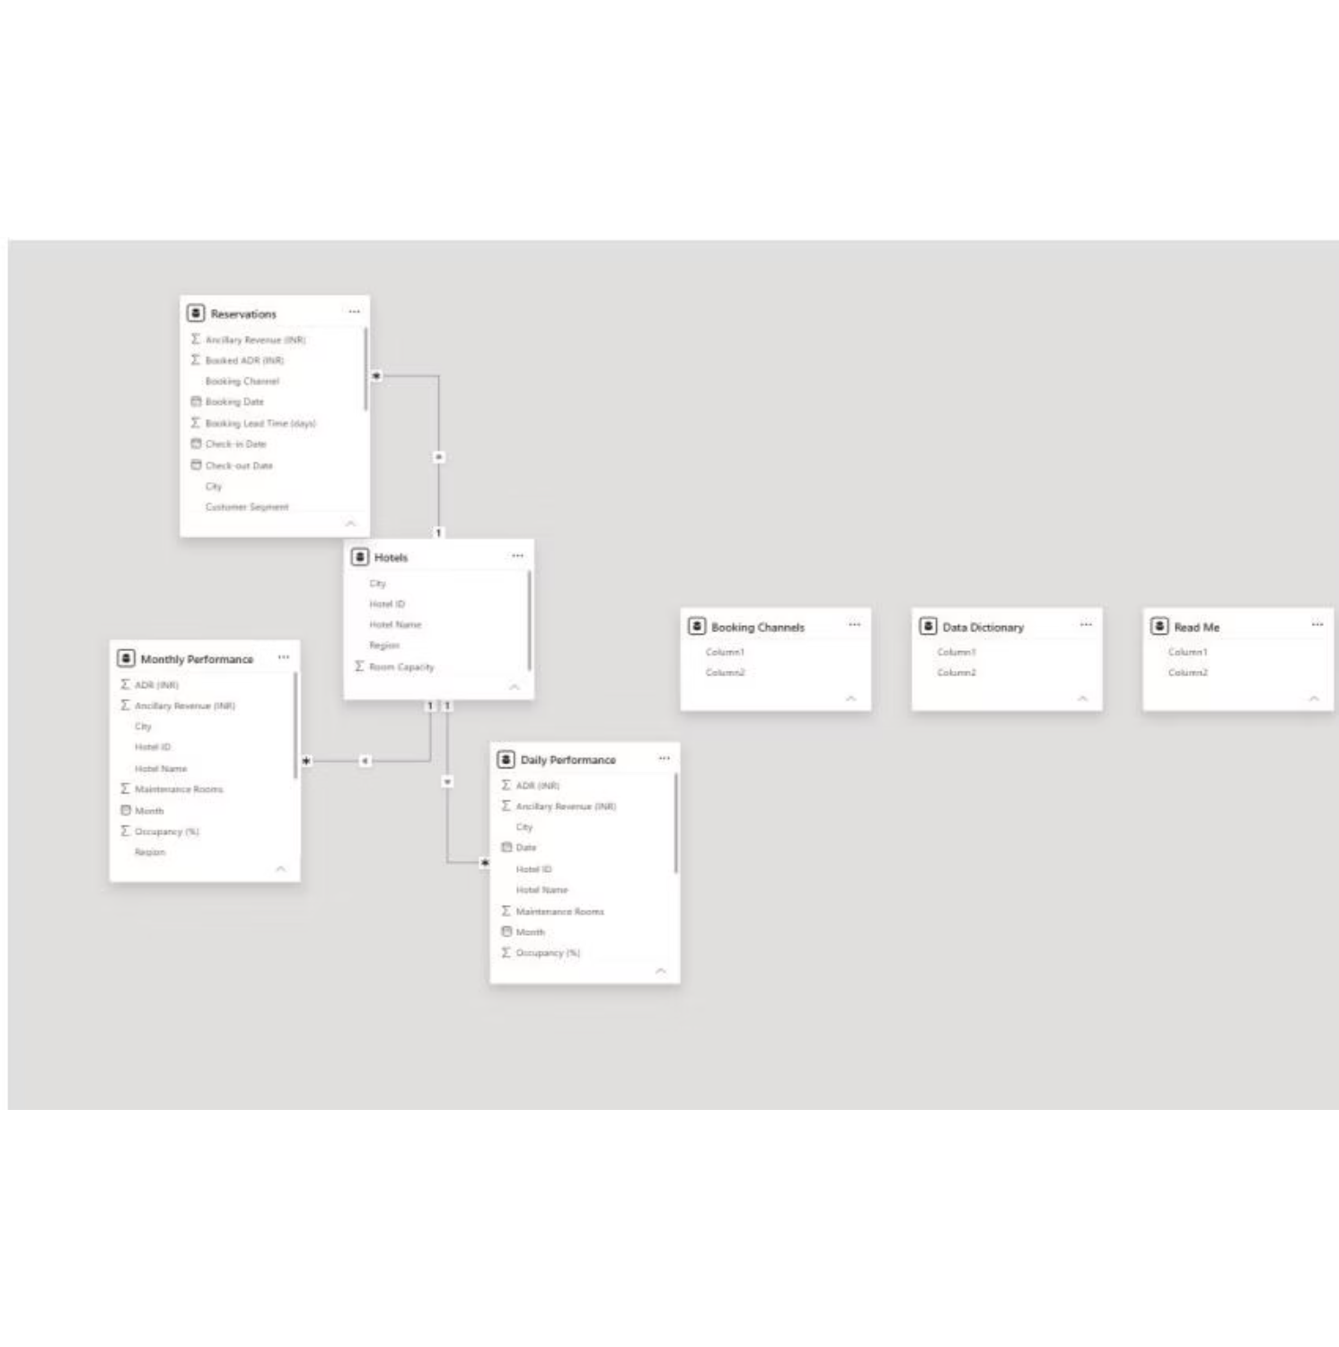
05
DATA ARCHITECTURE
04 · THREE LAYERS
Three data layers support the analysis
Prepare: Import, clean, standardize, validate, and type the source workbook in Power Query.
Model: Connect Hotels to Reservations, Monthly Performance, and Daily Performance, with booking-channel and documentation tables around them.
Relationship: Reservations represent booking-level records; Daily Performance represents daily hotel records. They support complementary views and are independent datasets, so totals may not reconcile exactly.
Calculate: Use DAX measures in the correct filter context and respect each table's grain.
SOURCE · hotel-revenue-management-dataset-1ev14h99 · 8,000 RESERVATIONS · 3,650 DAILY HOTEL RECORDS
FLOW · POWER QUERY → SEMANTIC MODEL → DAX MEASURES

Slide 6
06
MEASURE DISCIPLINE
05 · KPI RULES
KPI definitions prevent misleading totals
A number is only useful when its field, filter context, and data grain are explicit.
01
02
03
Revenue
Demand quality
Mix & grain
Use room revenue and ancillary revenue in the approved total-revenue field. ADR is revenue per sold room night; RevPAR relates revenue to available room capacity.
Occupancy compares occupied with available capacity. Cancellation rate and lead time must use their defined booking fields and current filter context.
Channel mix describes booking-source composition. Capacity and maintenance measures must respect the data grain and avoid repeated-snapshot double counting.
SOURCE · hotel-revenue-management-dataset-1ev14h99 · KPI COVERAGE: OCCUPANCY · ADR · REVPAR · ROOM REVENUE · ANCILLARY REVENUE · CANCELLATION RATE · LEAD TIME · CHANNEL MIX
CONTROL PRINCIPLE · DEFINE THE MEASURE BEFORE READING THE TOTAL
SO WHAT
Correct totals depend on the current filter context, the KPI definition, and the grain of the underlying data.

Slide 7
07
USER EXPERIENCE
06 · INTERACTION
Interaction turns one report into multiple views
01
02
03
Select
Compare
Inspect
Select a city, hotel, region, channel, or period.
Compare occupancy, ADR, RevPAR, room revenue, ancillary revenue, cancellations, lead time, or channel mix.
Use cross-highlighting, sorting, tooltips, and updated KPI context while keeping the dataset scope visible.
INTERACTION LOOP · FILTER → COMPARE → INSPECT · SOURCE · hotel-revenue-management-dataset-1ev14h99
SO WHAT
Interaction lets a reviewer move from a broad performance read to a specific analytical question without changing reports.

Slide 8




08
ACCEPTANCE APPROACH
REVIEW EVIDENCE
Acceptance is evidence, not a visual check
Sheet loads, data types, and 365-day date scope
REVIEW STANDARD
Reviewers should confirm final measures against the actual dataset definitions before treating the report as authoritative. Booking records and daily performance are independent and may not reconcile exactly.
KPI definitions, reconciliation checks, and filter behavior
Reservation versus daily-performance grain and visual readability
SOURCE · hotel-revenue-management-dataset-1ev14h99 · SYNTHETIC DATA FOR ACADEMIC USE
Refresh, authorized sharing, and synthetic-data labeling

